Slide 1
Improving Recommendations by including User-Specific Constraints, based on Domain Knowledge Sonja Dagn, Matteo Gläser, Ilyas Satik
Notes:
Hello,
my name is Sonja Dagn and I would like to welcome you to my final presentation of my bachelor thesis
with the topic Digitization in Manufacturing plants.
This thesis is supervised by Dr. Sashko Ristov.
Quality assurance plays a crucial role in companies to ensure that products meet high-quality standards.
The research topic of this study is the digitization in companies, especially the digitization of error catalogs for an efficient quality control.
To address this topic, it is necessary to replace traditional paper-based error catalogs with web-based solutions.

Slide 2
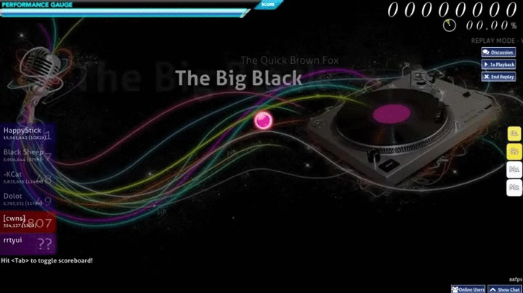
Osu! Game basics.
Rhythm Game
Music plays
Hit circles appear (beatmap)
Goal -> Click at the circles/elements in the correct order and time

Slide 3
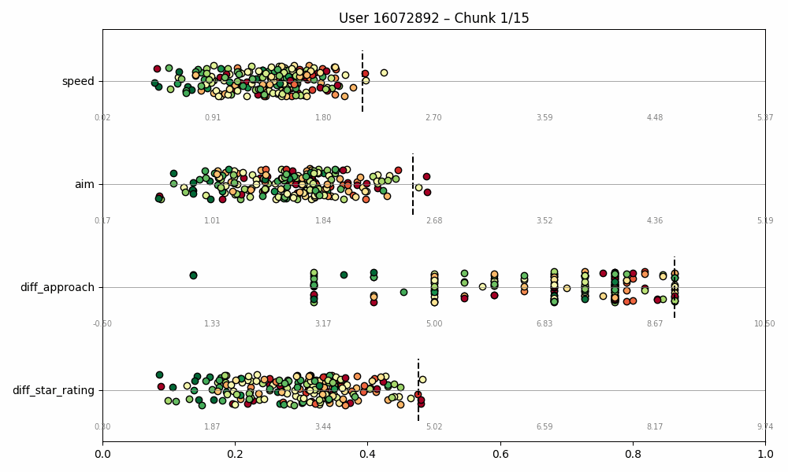
Why is our dataset appropriate for the RQ?
Improving Recommendations through User-based Constraints
How fast tapping and
how sustained?
How hard are elements
to hit (distance and angles)?
How fast do elements appear
Reaction/read time?
difficulty estimation

Slide 4
Dataset Preprocessing
Obtained through dump by Lead-Developer
High_scores for 10k random and top users
Sanitized, filtered for full attributes available, min interactions, etc. Feature engineering

Slide 5
Dataset Preprocessing
Obtained through dump by Lead-Developer
High_scores for 10k random and top users
Sanitized, filtered for full attributes available, min interactions, etc.
Feature engineering
Domain Challenges and Solutions
Beatmap + Mod Combinations Item explosion
Collapse into 4 Combinations: NM, DT, HD, DTHR. beatmap_{MOD} as items
User Improvement over time
Estimation of Skill Stabilization date for each user
No Explicit feedback, what rating metrics?
Calculation of enjoyment_factor, from mostly implicit feedback, fallback: playcount.

Slide 6
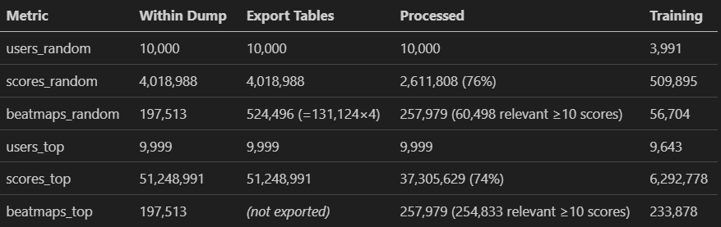
Dataset Preprocessing

Slide 7
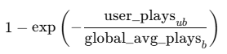
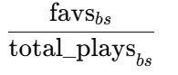
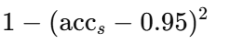
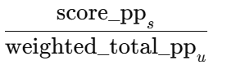
Enjoyment factor construction
Enjoyment of each score
0.2 * playcount_c
0.3 * favourite_c
0.2 * accuracy_c
0.3 * pp_contrib_c

Slide 8
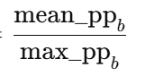
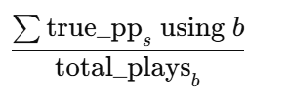
Enjoyment factor construction
Enjoyment of each score
0.2 * playcount_c
0.3 * favourite_c
0.2 * accuracy_c
0.3 * pp_contrib_c
balanced by
farm_factor

Slide 9
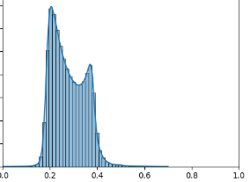
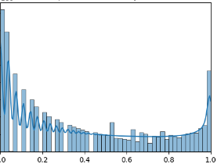
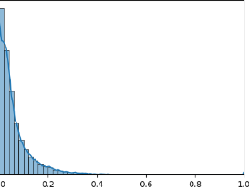
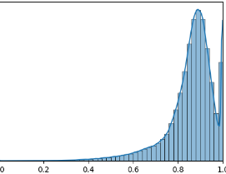
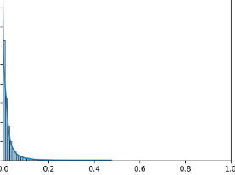
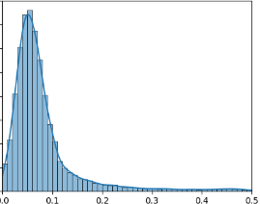
Enjoyment factor construction
Enjoyment of each score
balanced by

Slide 10
Enoyment factor construction
Enjoyment of each score
balanced by
Blue zenith 7*
Freedom dive DT 10*
No title HR 6 and 7*
Epitaph NM and HR 7/9*
PADORU DT 8*
Santa-san 5*
Crab Rave 5*
KARMANATIONS 6*
AaAaAaAAaAaAAa DT 7*

Slide 11
Methodology
For random and top trained: baseline, KNN(user), SVD
Implement user-specific constraints, on limiting attributes mentioned before
99 percentile ceilings on speed, aim, approach rate and difficulty.
Flag scores where any ceiling was violated
3-fold cross validation, evaluate Metrics on top k=100 recommendations, and again after filtering flagged scores.
MSE
AVG, TOP and MIN ground truth rating in k recommendations
Compute deltas for metrics above.
5. Averaged on Users and Manifolds.
6. Repeat but with playcount metric instead of enjoyment

Slide 12
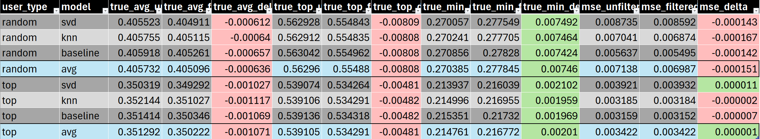
Results
Enjoyment rating
small deltas expected, when filtering with 99 percentile.
Positive deltas for min_rating => slight „precision“ improvement,
In all other columns negative deltas

Slide 13
Results
Enjoyment rating
For playcount rating is basically the same
- A bit more delta difference between random and top
- „coloring“ the same

Slide 14
RQ transferred
Constraints in Instacart Online Grocery Shopping Dataset 2017
Recently Purchased Filter
Max Items per Department
Aisle Diversity Constraint

Slide 15
Takeaways
Implementing user-constraints as a filter is easy
Might improve precision slightly, our results not clear enough to tell for sure.
Somewhat clean Osu! dataset with many interesting features in a RecSys unexplored domain created.

Slide 16
Thank you for your attention! Sonja Dagn, Matteo Gläser, Ilyas Satik
Notes:
Hello,
my name is Sonja Dagn and I would like to welcome you to my final presentation of my bachelor thesis
with the topic Digitization in Manufacturing plants.
This thesis is supervised by Dr. Sashko Ristov.
Quality assurance plays a crucial role in companies to ensure that products meet high-quality standards.
The research topic of this study is the digitization in companies, especially the digitization of error catalogs for an efficient quality control.
To address this topic, it is necessary to replace traditional paper-based error catalogs with web-based solutions.

Slide 17
Dataset Analysis

